Slide 1
Mining Binary Constraints in the Construction of Feature Models
Li Yi
Peking University
March 30, 2012

Slide 2
Agenda
Introduction
The Approach
Experiments
Conclusions & Future Work

Slide 3


Background: Feature Models
Feature Model
Construction (Domain Engineering) Requirements Feature Tree + Cross-Tree Constraints
Reuse (Application Engineering) Select a subset of features without violating constraints
EXAMPLE: A Feature Model of Audio Playing Software Domain
Audio Playing Software
Audio CD Codec
Burn CD
Platform
$$×$$
Optional
Mandatory
Mobile
PC
XOR-Group
Requires
$$×$$
Excludes

Slide 4
Help the Construction of FMs
The process needs a broad review of requirements documents of existing applications in a domain^{[1]}
(Semi-) Automation Supported
Feature Model = Feature Tree + Cross-Tree Constraints
?
[1] Kang et al. FODA Feasibility Study. 1990.

Slide 5
Finding Constraints is Challenging
Size of Problem Space: O(|Feature|² )
Feature: Often concrete, can be directly observed from an individual product vs. Constraint: Often abstract, have to be learned from a family of similar products
My Experience: Finding constraints is challenging for 30+ features
Real FMs tend to have 1000+ features
We try to provide some automation support.

Slide 6
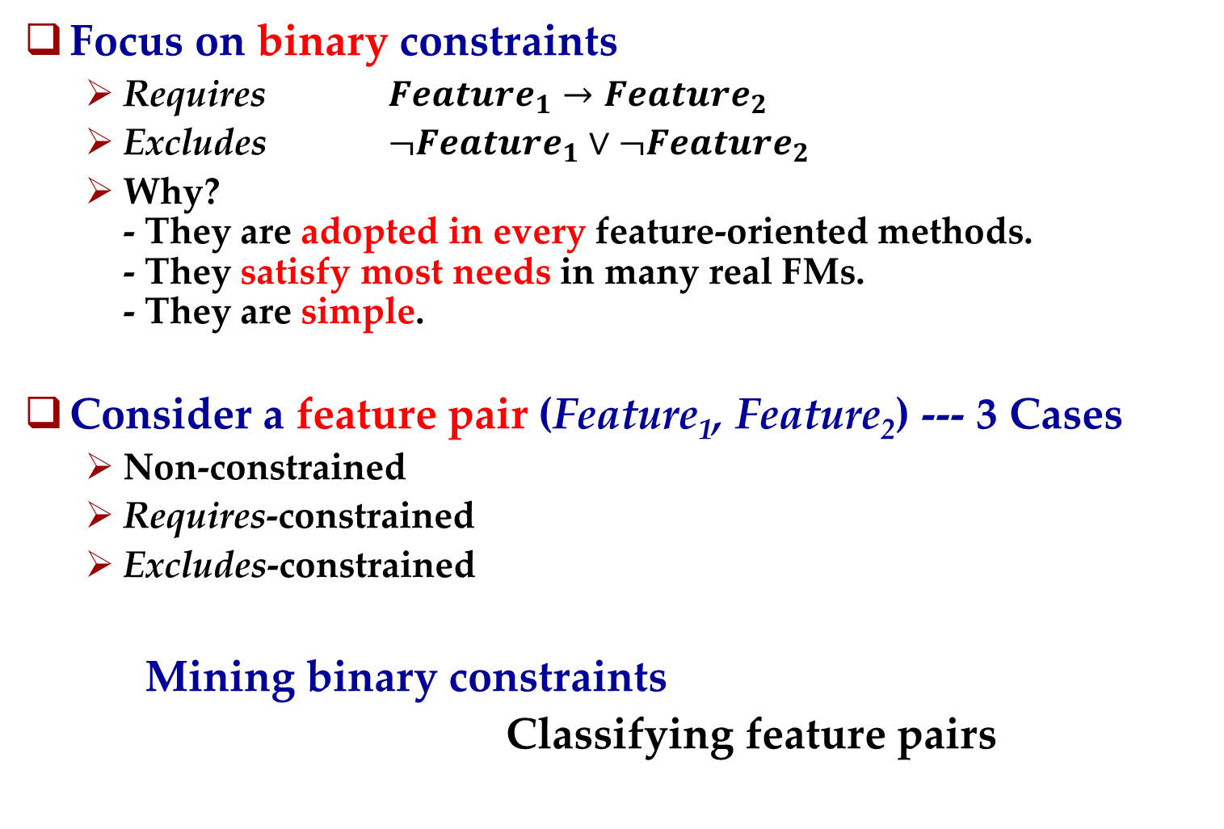
Our Basic Idea
Focus on binary constraints
Requires $Feature_{1}→Feature_{2}$
Excludes $¬Feature_{1}∨¬Feature_{2}$
Why? - They are adopted in every feature-oriented methods. - They satisfy most needs in many real FMs. - They are simple.
Consider a feature pair (Feature₁, Feature₂) --- 3 Cases
Non-constrained
Requires-constrained
Excludes-constrained
Mining binary constraints
Classifying feature pairs

Slide 7
Agenda
Introduction
The Approach
Experiments
Conclusions & Future Work

Slide 8
Approach Overview
Feature Pair
Training & Test Feature Models
Make Feature Pairs
Training & Test Feature Pairs
name₁: String
name₂: String
description₁: Text
description₂: Text
Training Vectors
Quantify Feature Pairs
Classifier
Train
Optimize
Trained Classifier
Test Vectors
Test
Classified Test Feature Pairs

Slide 9
Agenda
Introduction
Approach: Details
Make & Quantify Feature Pairs
Experiments
Conclusions & Future Work

Slide 10


Make Pairs
The pairs are cross-tree only and unordered
Cross-tree only: The 2 features in a pair have no “ancestor-descendant” relation
Feature Tree
A
$$×$$
B
C
(A, B) (A, X) (A, Y) (A, C) (B, X) (B, Y)
.
.
.
.
.
.
X
…
Y
(B, C) (X, Y) (C, X) (C, Y)
Unordered: (A, B) == (B, A)
requires(A, B): A requires B or B requires A or both

Slide 11
Quantify Pairs
Feature Pair
Feature Pair
name₁: String
name₂: String
description₁: Text
description₂: Text
attribute₁: Number
attribute₂: Number
…(more)
Classifiers work with numbers only.
We measure 4 numeric attributes for pair (A, B)
Similarity between A.description and B.description
Similarity between A.objects and B.objects
Similarity between A.name and B.objects
Similarity between A.objects and B.name
Similar Feature
Overlapped Function Area
One is targeted by another
These phenomena may indicate dependency / interaction between the paired features, and in turn, indicate constraints between them.

Slide 12
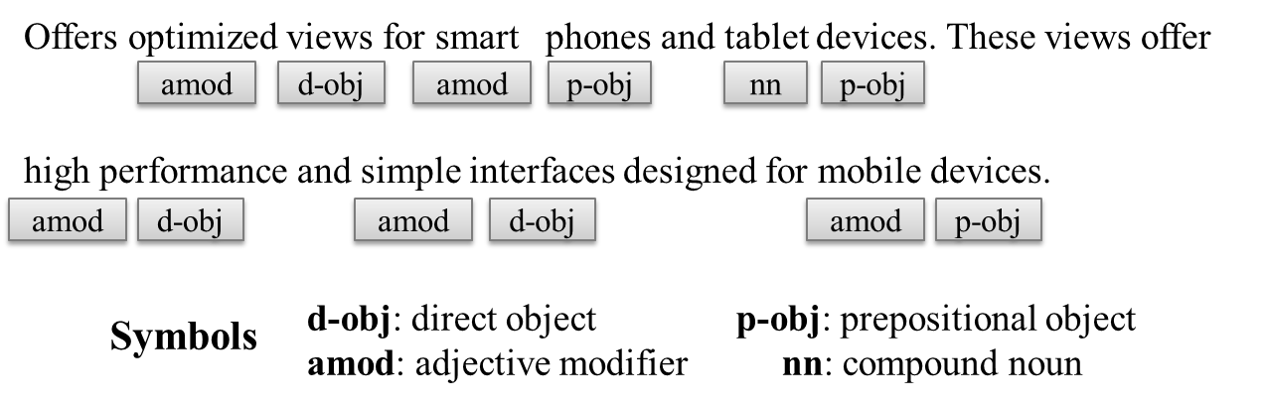
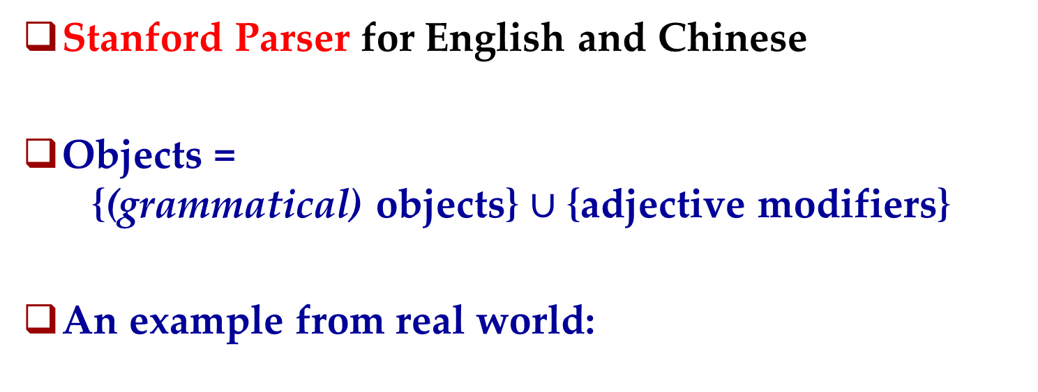
Extract Objects
Stanford Parser for English and Chinese
Objects = {(grammatical) objects} $∪$ {adjective modifiers}
An example from real world:

Slide 13

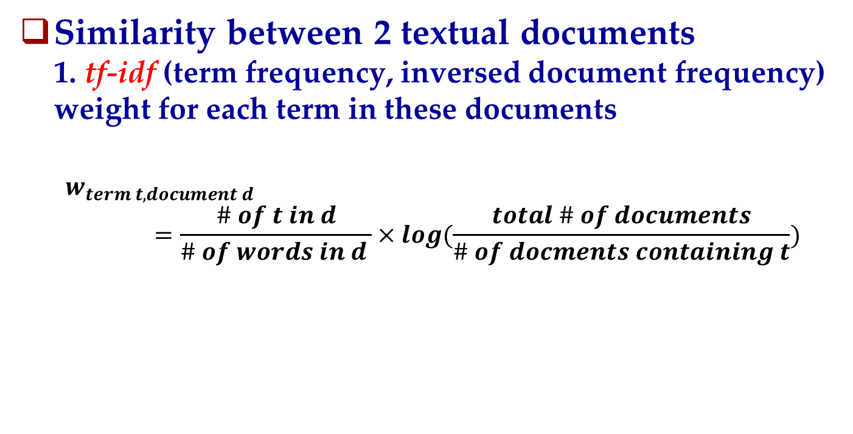
Calculate the Similarity
Similarity between 2 textual documents 1. tf-idf (term frequency, inversed document frequency) weight for each term in these documents
$$w_{term t, document d}=\frac{\# of t in d}{\# of words in d }×log(\frac{total \# of documents}{\# of docments containing t})$$
tf
idf
2. Documents = Vectors of tf-idf weights, so that
$$Similarity_{vector v_{1}, vector v_{2}}=\frac{v_{1}∙v_{2}}{|v_{1}|×|v_{2}|}$$
dot-product

Slide 14
Agenda
Introduction
Approach: Details
Train and Optimize the Classifier
Experiments
Conclusions & Future Work

Slide 15
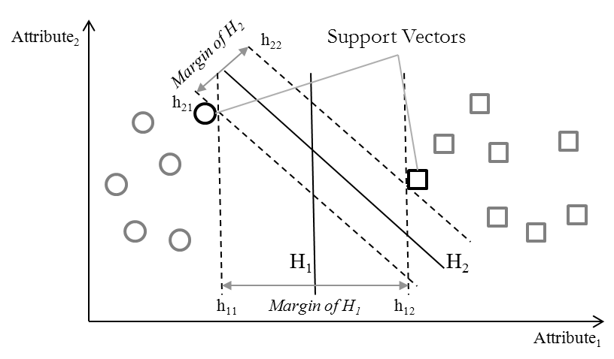
The Classifier: Support Vector Machine (SVM)
Idea: Find a separating hyperplane with maximal margin.
Implementation: The LIBSVM tool

Slide 16
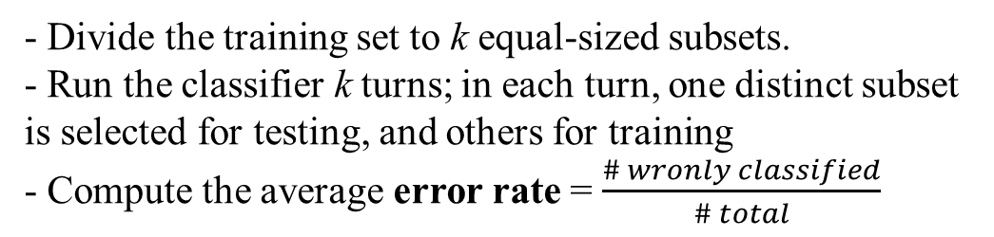
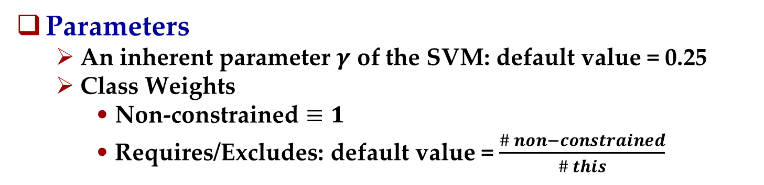

Optimize the Classifier
Parameters
An inherent parameter $γ$ of the SVM: default value = 0.25
Class Weights
Non-constrained $≡1$
Requires/Excludes: default value = $\frac{\# non−constrained}{\# this}$
Rationale: Correctly classify a rare class is more important.
Optimization: Find the best tuple (W_{requires,} W_{excludes,} $γ$)
Run k-fold cross-validation for a given tuple
Run a genetic algorithm to find values giving lowest error rate.
- Divide the training set to k equal-sized subsets.
- Run the classifier k turns; in each turn, one distinct subset is selected for testing, and others for training
- Compute the average error rate = $\frac{\# wronly classified}{\# total}$
k = 4

Slide 17
Agenda
Introduction
Approach: Details
Experiments
Conclusions & Future Work

Slide 18

Data Preparation
FMs in experiments are built by third parties
From SPLOT Feature Model Repository ^{[1]} (no feature description)
Graph Product Line: by Don Batory (91 pairs)
Weather Station: by pure-systems corp. (196 pairs)
Add Feature Description
Most features = Domain terminologies
Search terms in Wikipedia
Description = The first paragraph (i.e. the Abstract)
Other features: No description
[1] http://www.splot-research.org

Slide 19
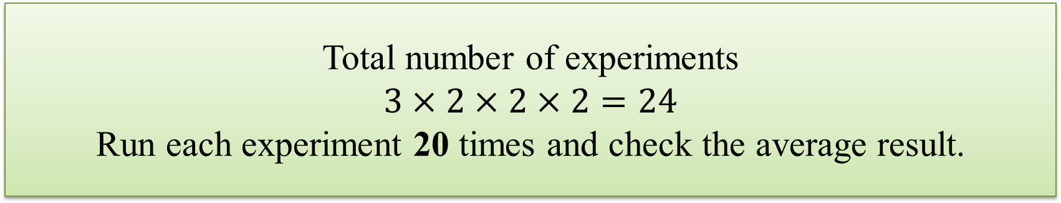
Experiments Design
3 Training / Test Set Selection Strategies
Cross-Domain: Training = FM₁, Test = FM₂
Inner-Domain: Training = 1/5 of FM₂, Test = Rest of FM₂
Hybrid: Training = FM₁ + 1/5 of FM₂, Test = Rest of FM₂
2 FMs: one as FM₁, another as FM₂; then exchange
2 Training Methods
Normal: Training with known data (i.e. training set)
LU-Method: Iterated training with known and unknown data
With or Without (Limited) Feedback
Total number of experiments
$$3×2×2×2=24$$
Run each experiment 20 times and check the average result.
Generate Training & Test Set
Optimize, Train and Test
Results
No Feedback
Generate Initial Training & Test Set
Training & Test Set
Optimize, Train and Test
Check a few results
Results
Limited Feedback
(An expected practice in real world)
Add checked results to training set;
Remove them from test set

Slide 20


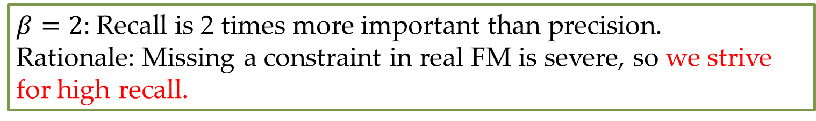
Measurements
Error Rate: The standard measurement in the research of classification
$Error Rate=\frac{\# Wrongly Classified}{\# Total}×100\%$
Precision, Recall and F₂-Measure for requires and excludes, respectively
$Precision=\frac{TP}{TP+FP}$
$Recall=\frac{TP}{TP+FN}$
$F_{β}=\frac{\left(β^{2}+1\right)×Recall×Precision}{Recall+β^{2}×Precision}$
 | Predicted Positive | Predicted Negative
Actual Positive | True Positive (TP) | False Negative (FN)
Actual Negative | False Positive (FP) | True Negative (TN)
$β=2:$Recall is 2 times more important than precision.
Rationale: Missing a constraint in real FM is severe, so we strive for high recall.

Slide 21
Results: Optimization
Feature Model | Training = WS, Test = GPL |  |  | Training = GPL, Test = WS
Strategy | Cross-Domain | Inner-Domain | Hybrid | Cross-Domain | Inner-Domain | Hybrid
Avg. Error % (with Default Parameter Values) | 18.2 | 72.89 | 2.89 | 16.17 | 64.68 | 12.97
Avg. Error % (Optimized) | 0.82 | 12.95 | 2.40 | 8.83 | 4.70 | 11.01
Before: Unstable (3% ~ 73%)
After: Stable (1% ~ 13%)
The optimization results are very similar to those reported in general classification research papers.

Slide 22
Results: Without Feedback
L = Normal Training, LU = LU-Training
 | Requires |  |  |  |  |  | Excludes
 | Precision % |  | Recall % |  | F₂-Measure |  | Precision % |  | Recall % |  | F₂-Measure
 | L | LU | L | LU | L | LU | L | LU | L | LU | L | LU
 | Training FM = Weather Station, Test FM = Graph Product Line
Cross-Domain | 7.5 | 17.53 | 100 | 94.44 | 0.288 | 0.503 | N/A | N/A | 0 | 0 | N/A | N/A
Inner-Domain | 14.95 | 12.14 | 84.67 | 93 | 0.438 | 0.399 | 100 | 100 | 100 | 100 | 1 | 1
Hybrid | 23.41 | 20.42 | 84 | 84.67 | 0.553 | 0.52 | 14.17 | 20.46 | 100 | 100 | 0.452 | 0.563
 | Training FM = Graph Product Line, Test FM = Weather Station
Cross-Domain | 66.67 | 50 | 100 | 100 | 0.909 | 0.833 | N/A | N/A | 0 | 0 | N/A | N/A
Inner-Domain | 92.67 | 86 | 100 | 94.67 | 0.984 | 0.928 | 22.14 | 2.68 | 80 | 100 | 0.525 | 0.121
Hybrid | 73.06 | 74.07 | 93.33 | 100 | 0.884 | 0.935 | 35.14 | 22.17 | 66.67 | 80 | 0.565 | 0.526
The cross-domain strategy fails to find any excludes.
No significant difference between inner-domain and hybrid strategies.
Recall is high. Precision depends on the test FM (unstable).
No significant difference between normal and LU- training, so we prefer the former one for saving training time.

Slide 23
Results: Normal Training + Feedback
3 feedbacks/ turn (i.e. 2% ~ 5% data)
10 turns
Improve Recall.
Precision is still fluctuate.
Help cross-domain find excludes.

Slide 24
Agenda
Introduction
Approach: Details
Experiments
Conclusions & Future Work

Slide 25
Conclusions & Future Work
Conclusions
Binary constraints between features → Classes of feature-pairs
The classifier should be optimized
High recall
Unstable precision
Preferred Settings: Inner-Domain/Hybrid Training Set + Normal Training + Limited Feedback
Future Work
More linguistic analysis (verb, time, etc.)
Real use

Slide 26
THANK YOU ! Q&A

